Slide 1
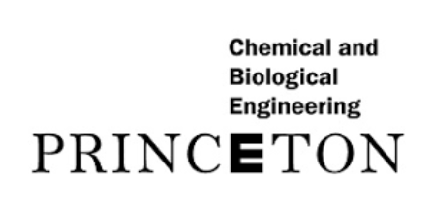

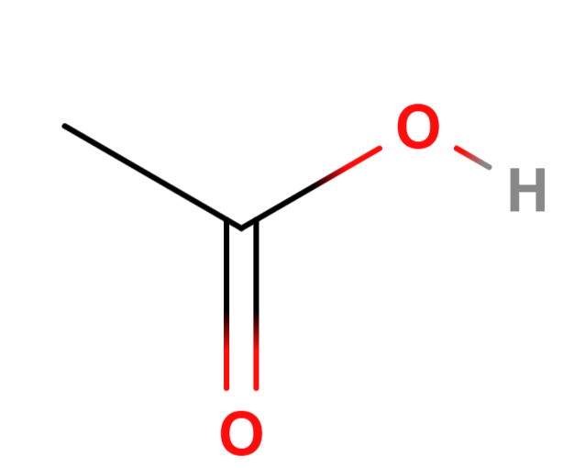
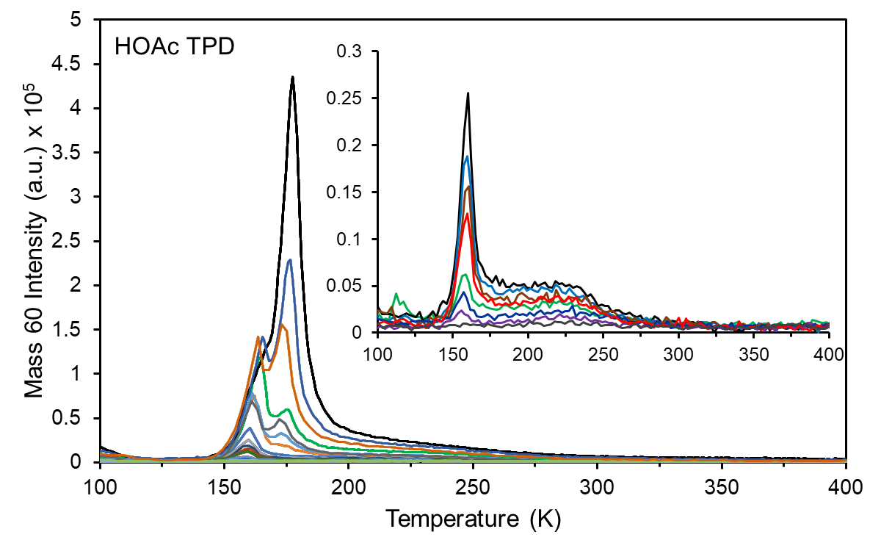
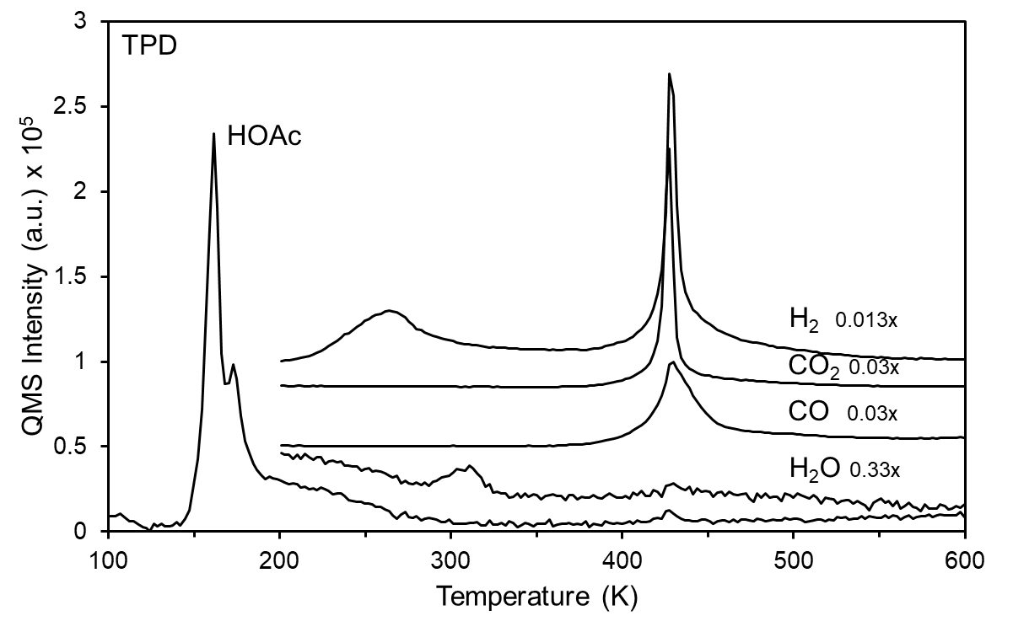
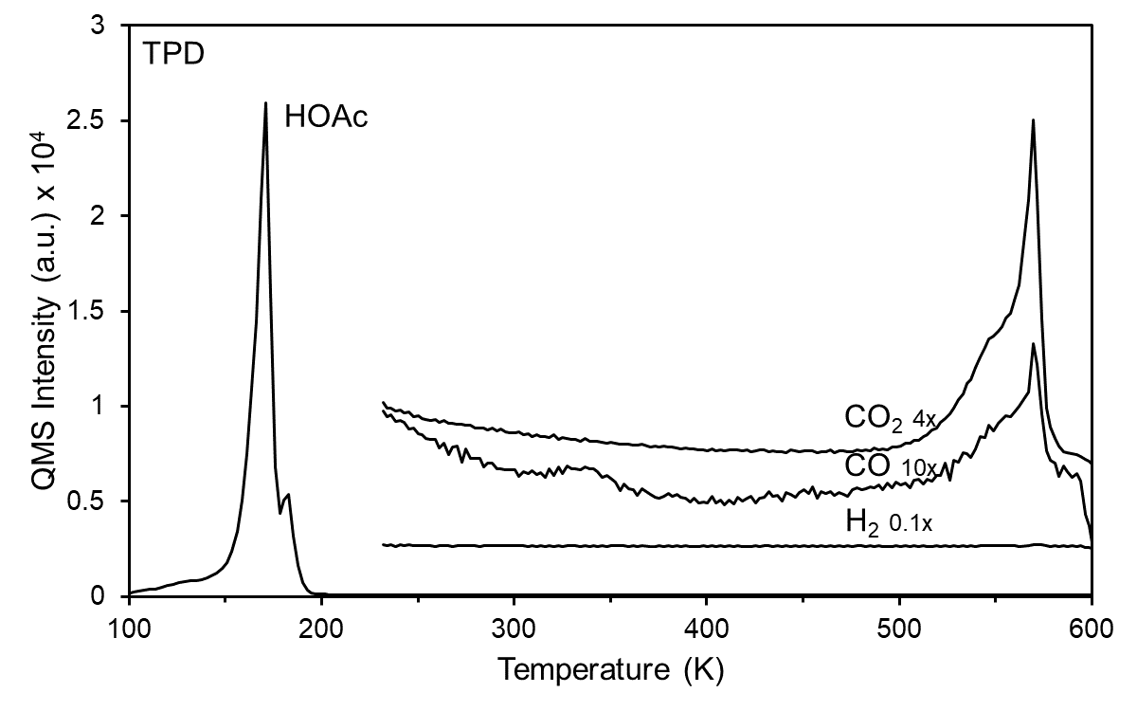
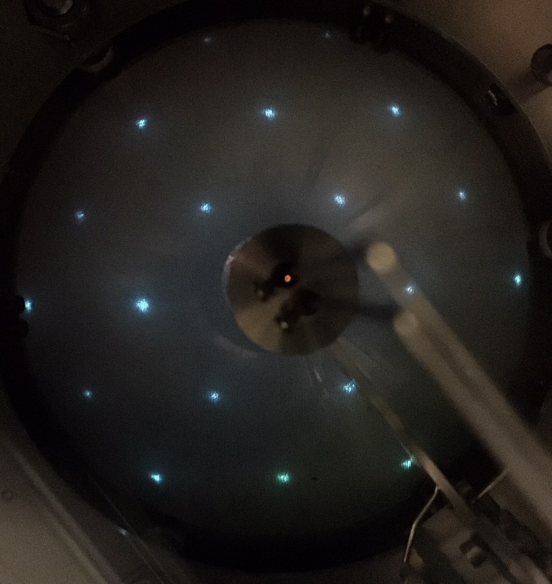
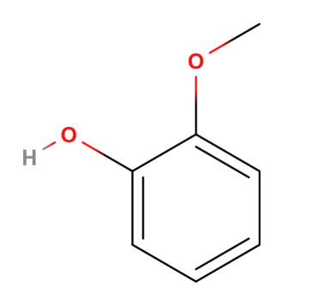
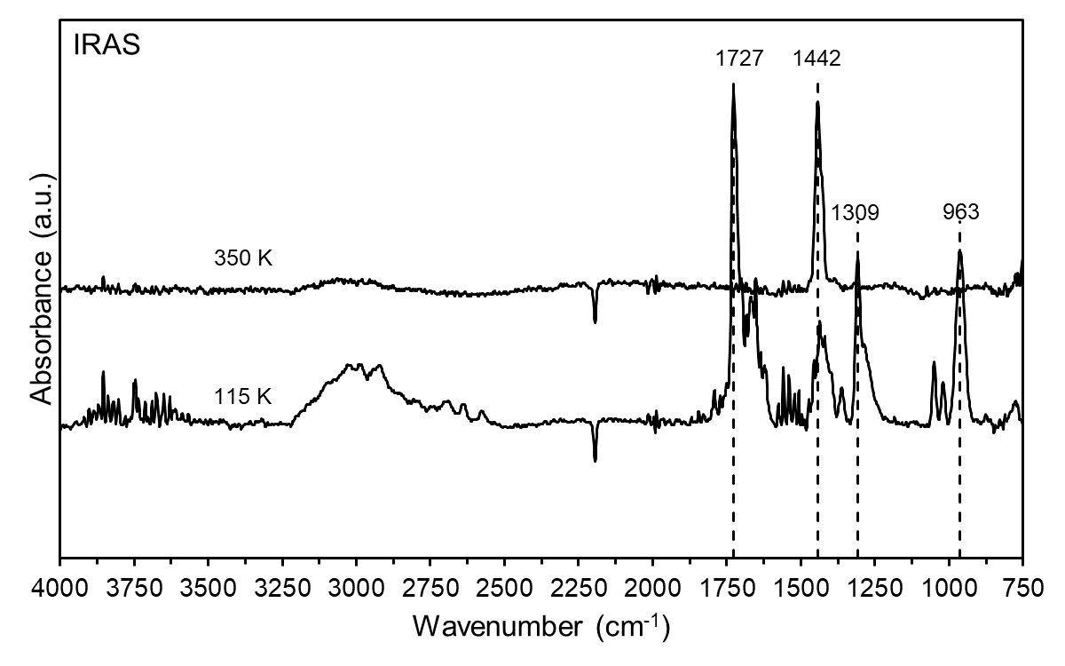
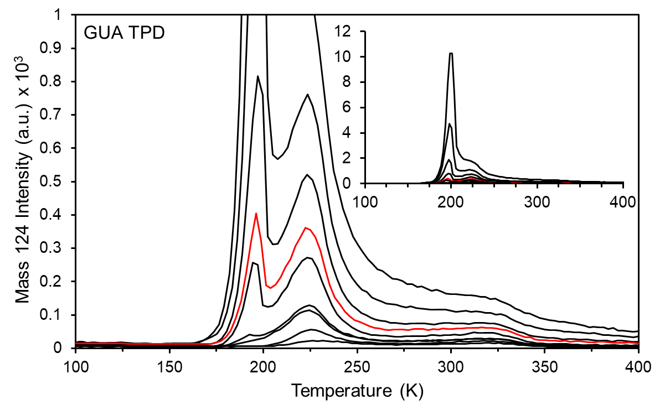
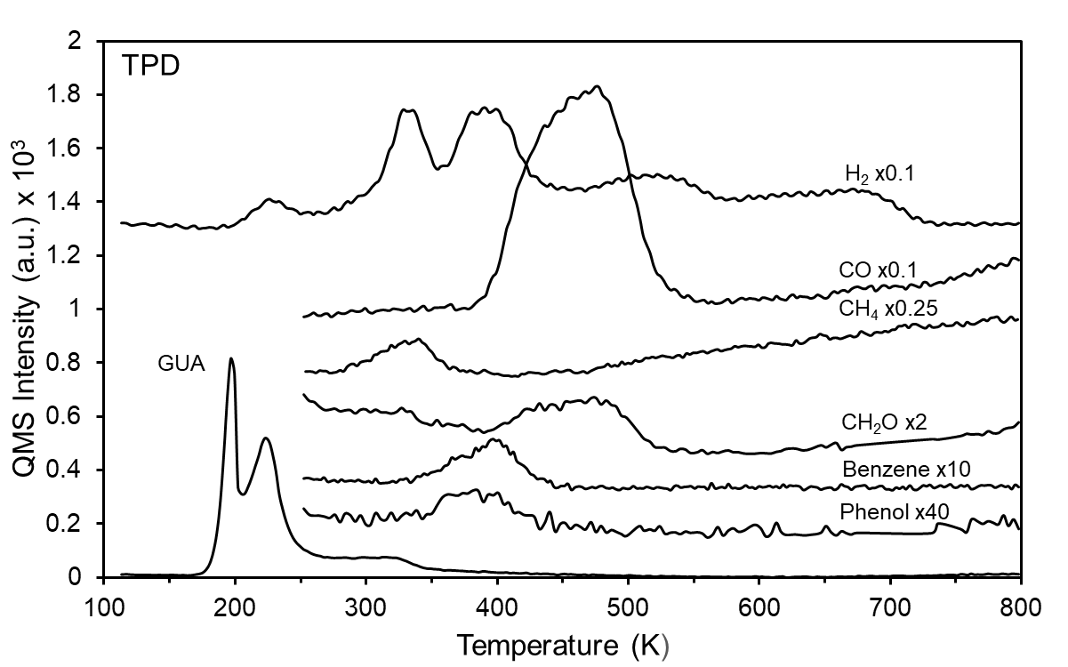
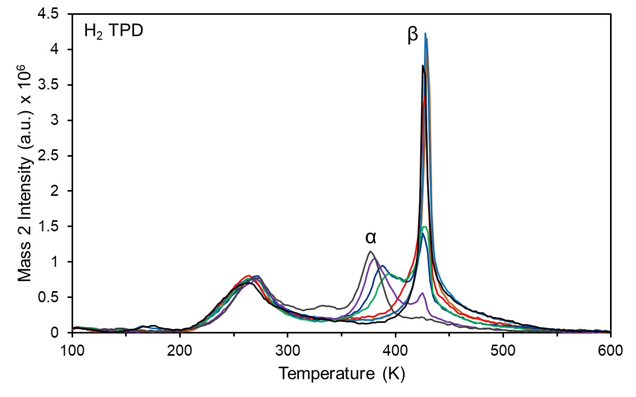
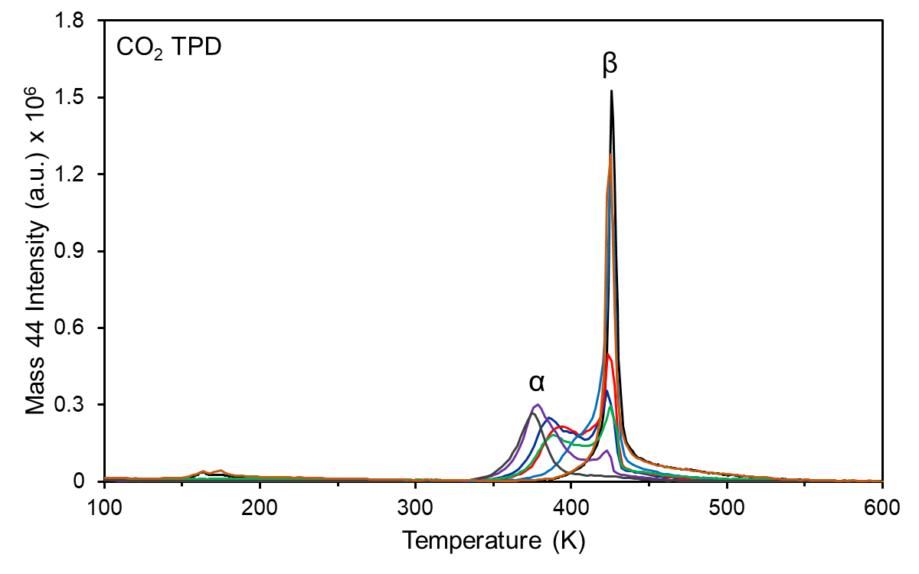
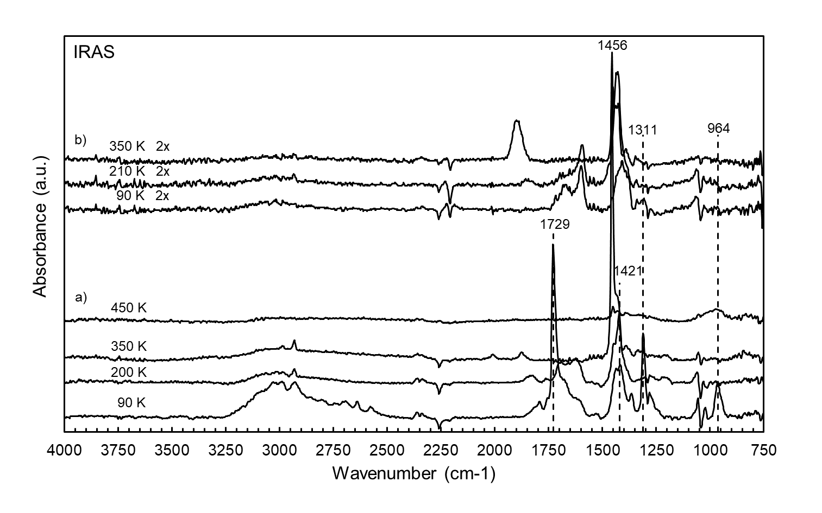
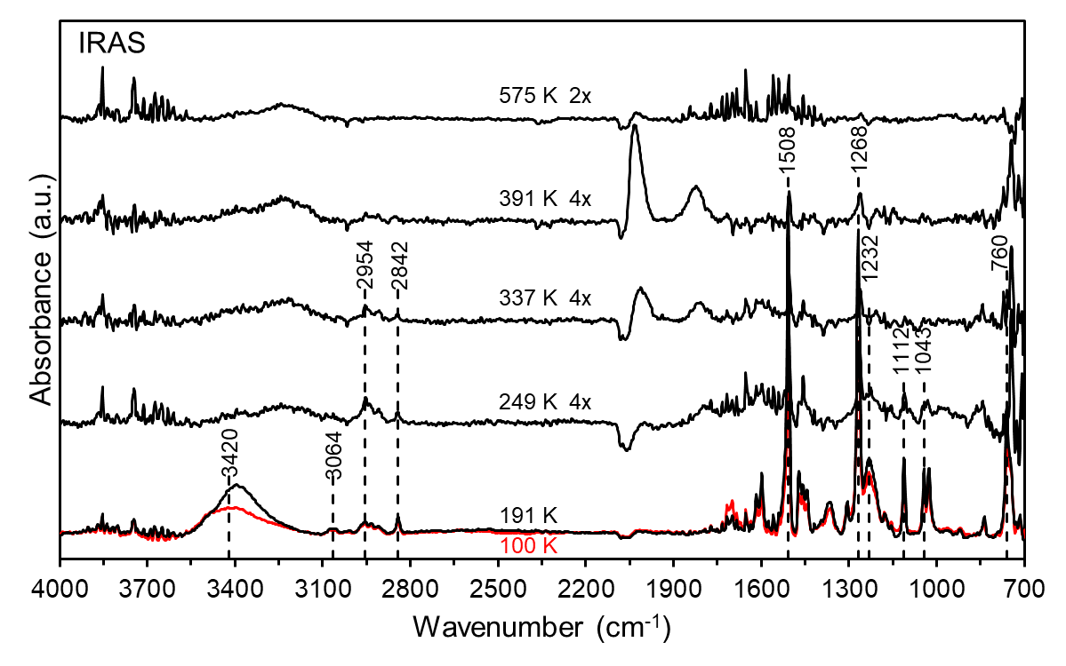
Adsorption and decomposition of model biomass compounds on
Pt(100) and Ni(110) catalyst surfaces
M. Hofman¹, E. Scoullos², and B. E. Koel²
¹Department of Chemistry, ²Department of Chemical and Biological Engineering, Princeton University
Motivation
Acetic acid on Ni(110)
Acetic acid on Sn/Ni(110)
Bio-oils are a renewable source of energy with a high oxygen content that complicates refining
Sulfided Ni-Mo supported catalysts for hydrodeoxygenation (HDO) are ineffective for processing bio-oils due to this high oxygen content
Fundamental surface chemistry of bio-oil compounds on prospective catalysts is not well understood
UHV studies of the adsorption and decomposition of model bio-oil compounds on single-crystal surfaces enable us to elucidate chemistry and reactions to aid design of improved catalysts
Acetic acid (HOAc) is a major product from the fast pyrolysis of hemi-cellulosic feedstocks such as switchgrass and alfalfa
Adsorption and decomposition of HOAC on a c(2x2) Sn/Ni(110) alloy was also studied
Decomposition of η²(O,O)-acetate gives rise to autocatalytic desorption of CO₂
Heating the adsorbed layer results in O-H bond scission, forming η²(O,O)-acetate
Guaiacol on Pt(100)
HOAc desorbs in a recombinative peak at 220 K
Desorption of acetic acid dimers and catemers occurs at 157 and 172 K, respectively
Decomposition of HOAc leads to the desorption of H₂O, CO, CO₂, and H₂
Guaiacol (2-methoxyphenol) is the major lignin-
derived compound in fast pyrolysis of bio-oils
Conclusions
Guaiacol decomposition occurs by hydrogenolysis of the hydroxyl group followed by unselective cleavage of C‒O bonds, which leads to the desorption of H₂, CO, CH₄, CH₂O, and small amounts of benzene and phenol
HOAc dissociatively adsorbs on Ni(110) forming a η¹(O)-acetate species, which then either decomposes or forms a η²(O,O)-acetate species below 350 K.
Above 350 K η²(O,O)-acetate decompose into H₂ and CO_{2,}, which coincidentally desorb on Ni(110)
On Ni(110), H₂ and CO₂ desorb from the low temperature α peak at low coverages and the high temperature autocatalytic β peak at high initial HOAc coverages
On the less reactive c(2 × 2) Sn/Ni(110) alloy, HOAc forms a chemisorbed η²(O,O)-acetate species, which does not decompose until above 500 K
Guaiacol (GUA) desorbs molecularly at 225 K and recombinatively at 320 K
Physisorbed species desorb in a low temperature multilayer peak at 195 K
Decomposition leads to desorption of H₂, CO, CH₄, CH₂O, and small amounts of benzene and phenol
Decomposition of η²(O,O)-acetate above 350 K leads to an autocatalytic “surface explosion” and the desorption of H₂ and CO₂
As the coverage of η²(O,O)-acetate increases, the α peak at 380 K reduces in intensity and shifts to higher temperature and the narrow autocatalytic β peak emerges.
HOAc dissociatively adsorbs, forming a η¹(O)-acetate species
η¹(O)-acetate either decomposes or forms a η²(O,O)-acetate species
Decomposition of η²(O,O)-acetate leads to a “surface explosion,” leaving residual carbon on the surface and desorption of H₂ and CO₂ products at 425 K
Acknowledgements
Hydrogenolysis of the hydroxyl group occurs by 249 K, followed by unselective cleavage of C‒O bonds
We thank to Denis Potapenko and Xiaofang Yang for their support and thoughtful discussions regarding the work in this project
This work is supported by the National Science Foundation Award No. 1264453

